Slide 1
Weather
Q
What is an occluded front and what does it look like on a prognosis chart?

Slide 2
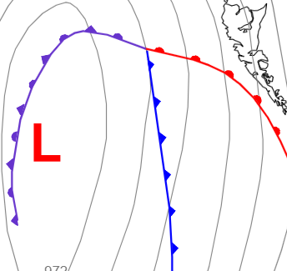
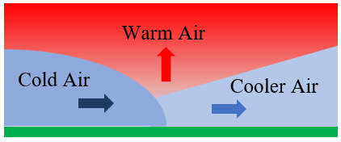
Weather
An occluded front occurs when a cold air mass catches up to a warm front. The warm air is “occluded” or blocked from reaching the ground as it rises up and over the cold air. It is usually a sign the predominant recent weather has reached its mature stage. An occluded front is depicted by a purple frontal line with purple spikes and humps. When looking for an occluded front on a prog chart, always look for the “shark fin” formed by a cold front overtaking a warm front. You will usually find an occluded front there.
“Shark fin”

Slide 3
Weather
Q
How often are TAFs issued?
AIM 7-1-3

Slide 4
Weather
TAFs are issued every six hours.

Slide 5
Weather
Q
What is a dry line and what does it look like on a prognosis chart?

Slide 6

Weather
It is the boundary between two air masses of differing moisture content with one being dryer than the other.

Slide 7
Weather
Q
How long are Convective SIGMETs valid for?

Slide 8

Weather
Two hours unless superseded by the next issued SIGMET.

Slide 9
Weather
Q
Describe advection fog.

Slide 10

Weather
Advection fog forms due to moist air moving over a colder surface, and the resulting cooling of the near-surface air to below its dew point temperature. Advection fog occurs over both water (steam fog) and land.

Slide 11
Weather
Q
Describe ice fog.

Slide 12

Weather
Ice fog is composed of ice crystals instead of water droplets and forms in extremely cold, arctic air. Ice fog of significant density is found near human habitation, in extremely cold air, and the burning of hydrocarbon fuels add large quantities of water vapor to the air. Steam vents, motor vehicle exhausts, and jet exhausts are major sources of water vapor that produce ice fog. A strong low-level inversion contributes to ice fog formation by trapping and concentrating the moisture in a shallow layer.

Slide 13
Weather
Q
How often are Convective SIGMETs issued?

Slide 14
Weather
CONV SIGMETs are issued every two hours at 55 min past the hour.
If you think about it for a moment, this makes sense. CONV SIGMETs are associated with more severe weather so it makes sense that CONV SIGMETs would be issued more frequently than a SIGMET or AIRMET.

Slide 15
Weather
Q
Describe upslope fog.

Slide 16

Weather
Upslope fog occurs when sloping terrain lifts air, cooling it adiabatically to its dew point and saturation. Upslope fog generally forms at the higher elevations and builds downward into valleys. This fog can maintain itself at higher wind speeds because of increased lift and adiabatic cooling. Upsloping winds more than 10 to 12 knots usually result in stratus clouds rather than fog.

Slide 17
Weather
Q
How does frost affect an airfoil?

Slide 18
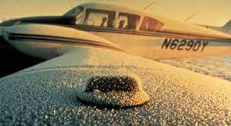
Weather
Frost creates airflow separation and reduces the amount of lift generated by the wing. It also increases drag.

Slide 19
Weather
Q
What is temperature / dewpoint spread?

Slide 20
Weather
The difference between the current temperature and current dew point. When the spread reaches zero, precipitation will occur.
Temp and dew point will be separated by a slash “/” on a METAR. In the example below, the temp is 23C and the dew point is minus 2C; therefore, the spread is 25 degrees.
In METAR below, the temperature/dew point spread is 25 degrees.
KDEN 010300Z 0103/0206 23/M02 VRB06KT P6SM VCSH FEW030 BKN080 OVC100

Slide 21
Weather
Q
What type of clouds usually indicate the presence of turbulence?

Slide 22

Weather
Cumulus and/or cumulonimbus clouds.

Slide 23
Weather
Q
What key feature of a thunderstorm marks the end of the “mature” stage and the beginning of the dissipating stage of thunderstorm development?

Slide 24
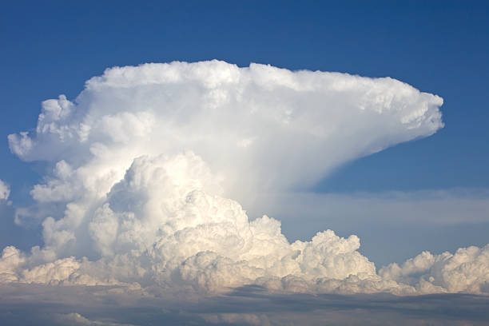
Weather
The “Anvil Top.”

Slide 25
Weather
Q
You are flying at night and find yourself in a thunderstorm. What should you do?

Slide 26
Weather
Turn on pitot heat and defrost.
Turn off strobes if they are distracting.
Set airspeed less than Va.
Turn off autopilot.
Turn interior lights to full intensity.
Don’t chase speeds and altitudes. Set a power setting and leave it there. Focus on maintaining straight and level pitch and bank.
Personally, I would do an instrument 180-degree turn and go back to where I came from. It will take you about 2 minutes at half standard rate.

Slide 27
Weather
Q
Typically, AIRMETs and SIGMETs cover at least _______ square miles.

Slide 28

Weather
3,000 square miles. Sometimes the specific weather phenomena covers only a small portion of the 3,000 square mile area – as little as 40%.

Slide 29
Weather
Q
What is wind shear?

Slide 30
Weather
Wind shear is defined as the rate of change of wind velocity (direction and/or speed) per unit distance; conventionally expressed as vertical or horizontal wind shear. It may occur at any level in the atmosphere but three areas are of special concern:
  1) Wind shear with a low-level temperature inversion.
  2) Wind shear in a frontal zone or thunderstorm.
  3) Clear air turbulence (CAT) at high levels associate with a jet stream or strong circulation.

Slide 31
Weather
Q
You are flying a 430-mile cross country. You fail to adjust your altimeter setting as you fly from a region of high pressure to a region of low pressure. Assuming you flew at a constant altitude as read on your altimeter, are you now closer to the ground or further?

Slide 32

Weather
As you continue flying along, you are getting closer to the ground although the altitude on your altimeter stays the same. Remember “High to Low, Look Out Below.” As you fly from a high-pressure region to a low-pressure region, you will work your way closer to the ground if you do not adjust your altimeter setting.

Slide 33
Weather
Q
What are the three types of weather briefings you may receive from a briefer?

Slide 34

Weather
Standard
Abbreviated
Outlook

Slide 35
Weather
Q
What two factors affect the stability of the atmosphere?

Slide 36
Weather
Temperature and moisture.

Slide 37
Weather
Q
When setting your altimeter, you should use a setting that is within ______ miles of your location.

Slide 38
Weather
100 miles.

Slide 39
Weather
Q
Interpret this METAR…
METAR KDEN 272153Z 24025G33KT 10SM SCT043 SCT060 BKN110 BKN150 14/03

Slide 40
Weather
Issued by KDEN on the 27th at 21:53Z. Winds are from 240 at 25 gust 33 kts. 10 miles visibility. 4,300 scattered, 6,000 scattered, 11,000 broken, 15,000 broken, temperature 14C, dewpoint 3C.

Slide 41
Weather
Q
What three conditions must be present for thunderstorm development?

Slide 42

Weather
Sufficient water vapor.
An unstable lapse rate.
An initial upward movement to start the storm process in motion.

Slide 43
Weather
Q
You are 300 miles from your destination; how can you obtain weather at your destination?

Slide 44
Weather
You are probably too far away to receive weather information directly from your destination so you’ll need to be creative.
The most timely and accurate means would be to contact FSS using a nearby RCO frequency. As a backup, you can use the weather data link through your avionics (ex: ADS-B In), ForeFlight, or reach out to ATC.

Slide 45
Weather
Q
What is "dew point?"

Slide 46
Weather
Dew point is the temperature to which a sample of air must be cooled to attain a state of saturation.

Slide 47
Weather
Q
What is a standard day?

Slide 48
Weather
15 deg C (59 deg F).
A pressure altitude of 29.92 inches of mercury.

Slide 49
Weather
Q
What is density altitude and how do you calculate it?

Slide 50
Weather
DA is pressure altitude corrected for non-standard temperature. It can be calculated using charts or an E6B flight computer. You can also use the following formula:
Fahrenheit
DA = PA + 66(T – ST)
Celsius
DA = PA + 118.8(T – ST)
Where:
PA – Pressure Altitude
T – Actual Temperature
ST – Standard Temperature

Slide 51
Weather
Q
What is an AIRMET?
AIM 7-1-6

Slide 52
Weather
Advisories of significant weather phenomena that describe conditions at intensities lower than those requiring the issuance of SIGMETs.

Slide 53
Weather
Q
What two formats are used to issue AIRMETs?
AIM 7-1-6

Slide 54
Weather
AIRMET information is available in two formats: text bulletins (WA) and graphics (G-AIRMET). They are issued on a scheduled basis every 6 hours beginning at 0245 UTC. Unscheduled updates and corrections are issued as necessary.

Slide 55
Weather
Q
What weather phenomena will a CONV SIGMET report?

Slide 56

Weather
Convective SIGMETs report winds 50kts or greater, hail ¾ inch or greater, and tornados. All of this implies thunderstorms or embedded thunderstorms. Also, lines of thunderstorms 60 miles long or greater.

Slide 57
Weather
Q
What is the primary means of obtaining a weather briefing?
AIM 7-1-2

Slide 58
Weather
The primary source is an individual briefing obtained from a briefer at the AFSS/FSS. These briefings, which are tailored to your specific flight, are available 24 hours a day through the use of the toll-free number (1-800-WX-BRIEF).

Slide 59
Weather
Q
You are with a friend on an VFR cross country to KAMA to go eat at the Big Texan. You are cruising at 7,500 MSL and note your OAT is 10 deg C. You later climb to 9,500 MSL. You friend bets you a steak dinner that you can’t guess the current OAT. You take him on.
What is your guess?

Slide 60
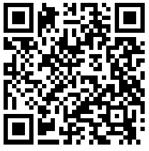
Weather
Your general knowledge is above average (because you have these cards of course!) and you know the standard lapse rate is 2 deg C decrease in temperature for every 1,000-foot altitude gain. So, you guess an OAT of 6 dec C.
Make your friend pay dearly for questioning your aviation prowess!

Slide 61
Weather
Q
What are the three stages of thunderstorm development?

Slide 62

Weather
Cumulus (developing)
Mature
Dissipating

Slide 63
Weather
Q
What is precipitation fog?

Slide 64

Weather
This is fog that forms when rain is falling through cold air. This is common with a warm front but it can occur with cold fronts if the cold front is not moving fast. Cold air, dry at the surface while rain is falling through it, evaporates and causes the dew point to rise.

Slide 65
Weather
Q
What is radiation fog?

Slide 66

Weather
Radiation cooling produces this type of fog. Under stable nighttime conditions, long-wave radiation is emitted by the ground; this cools the ground, which causes a temperature inversion. In turn, moist air near the ground cools to its dew point.

Slide 67
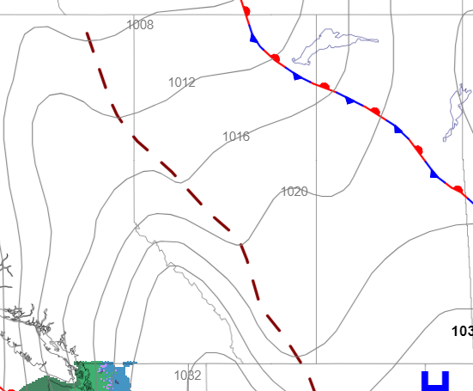
Weather
Q
You are reviewing a prognosis chart (prog chart) and see this. What is it?

Slide 68
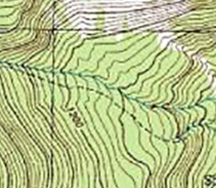
Weather
It is a called a trough or trough line. Notice how it connects the lowest points along the isobar lines? Imagine what a valley would look like on a topographical map. The topo map might show a river or road connecting all of the lowest elevation points along the map.
Topo Map with River
Prog Chart with Trough

Slide 69
Weather
Q
What are the three types of AIRMETs?

Slide 70

Weather
AIRMET – T : Turbulence
AIRMET – S : IFR and/or Mountain Obscuration
AIRMET – Z : Icing
Helpful hints:
“T” for Turbulence
“S” for Sierra Nevada Mountains
“Z” for Freezing

